Slide 1

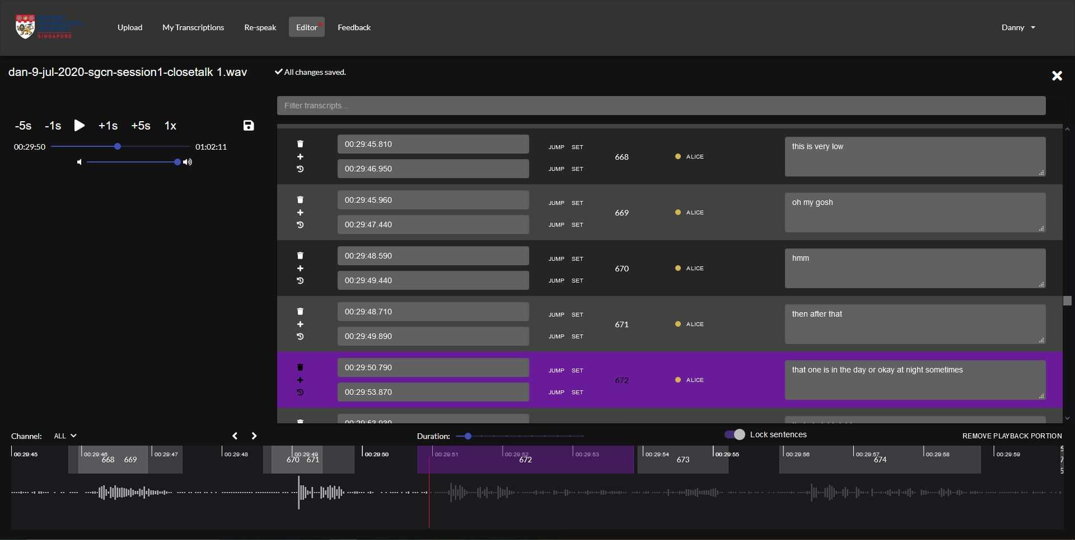
Web Interface for
Automated Speech Recognition Transcriber
Student: Nguyen Dinh Le Dan Supervisor: Assoc Prof Chng Eng Siong
Project Objectives:
This project aims to create a management system for the training of an automated speech recognition (ASR) transcriber, equipped with the ability to manage users, upload, view and edit transcriptions. With a rich set of features, this application can also transform into an interface for users to use the ASR when the transcriber is completed and is deployed as a product.
Powered by
React
Redux
Axios
Wavesurfer
Material UI
Application Editor
www.scse.ntu.edu.sg

